Slide 1

Dayananda Sagar College of Engineering
Department of Electronics & Communication Engineering
Section : B
Batch No : 18
RFid BASED HIGHWAY TOLL TAX COLLECTION SYSTEM
USN : 1DS22EC098 Name : Kaushik K C
USN : 1DS22EC120 Name : Manish S

Slide 2
Table of Contents
Introduction
Methodology
Description
Analysis and Findings
Discussion
Reference

Slide 3
Introduction
The integration of Radio Frequency Identification (RFID) technology into highway toll tax collection systems represents a significant advancement in transportation infrastructure.
Traditional toll collection methods, which often rely on manual operations or simple electronic systems, are prone to inefficiencies such as long wait times, traffic congestion, increased operational costs, and a higher likelihood of human error.
RFID technology, characterized by its contactless and automated nature, offers a modern solution aimed at enhancing the efficiency and accuracy of toll collection processes.
By utilizing RFID tags affixed to vehicles and RFID readers installed at toll points, this system facilitates the seamless and automatic deduction of toll fees as vehicles pass through toll booths, thereby promising substantial improvements in both operational efficiency and user experience.

Slide 4
Problem Statement
Traditional toll collection methods are plagued with inefficiencies, including long queues, high operational costs, and significant error rates in transaction processing
The primary problem addressed in this case study is whether an RFID-based toll collection system can effectively reduce these inefficiencies and improve overall toll management.
``

Slide 5
OBJECTIVE
To assess the effectiveness of RFID technology in improving the efficiency of highway toll tax collection.
To analyse the impact of RFID systems on reducing traffic congestion and improving traffic flow at toll plazas.
To evaluate the economic benefits of RFID-based toll collection, including potential reductions in operational costs and increased revenue accuracy.
To identify the challenges and limitations associated with the deployment and operation of RFID systems in toll collection.

Slide 6
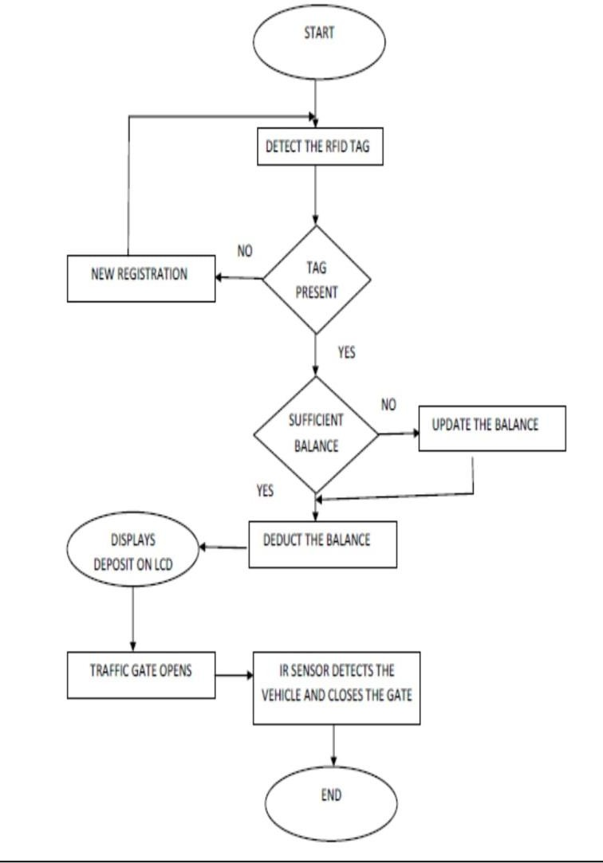
Block diagram

Slide 7
Working
This study employs a mixed-method research design, combining both quantitative and qualitative approaches.
To provide a comprehensive analysis of the RFID-based highway toll tax collection system.
The mixed-method design allows for a robust examination of both numerical data and user experiences, ensuring a holistic understanding of the system's impact
The quantitative includes data on transaction volumes, processing times, and traffic flow.
The qualitative component involves feedback from highway users and insights from system operators
Surveys :They were conducted among highway users to gather feedback on their experiences with the RFID toll collection system.
Traffic Flow Data :Traffic flow data was monitored using traffic sensors and cameras installed at and around the toll plaza. This data includes vehicle counts, average speed, and congestion levels at different times of the day.

Slide 8
Limitations
Initial Cost:The upfront investment required for RFID infrastructure, including tags, readers, and backend systems, can be substantial. This cost may be a barrier for some regions or smaller-scale implementations.
Maintenance Needs: Regular maintenance is crucial to ensure the system's continued reliability and efficiency. This includes cleaning and replacing damaged or dirty tags, as well as updating software and hardware components.
Technical Issues: Although infrequent, technical issues such as tag readability problems and system malfunctions can affect the system's performance. These issues need to be promptly addressed to maintain user confidence and system efficiency.
User Adaptation: Some users may initially face challenges adapting to the new system, especially if they are accustomed to manual toll collection methods. Ongoing user education and support are necessary to facilitate this transition.

Slide 9
Conclusion
RFID-based toll collection systems offer a viable solution to the inefficiencies of traditional toll methods. Key benefits include improved traffic flow, enhanced revenue accuracy, and reduced operational costs.
However, considerations of initial implementation costs and potential technical challenges are essential for successful adoption.

Slide 10
References Used
RFID based toll collection system 2011 IEEE third international Conference
Active Wave Inc. http://www.activewaveinc.com
Smart key Access Control System http://www.smartkey-rfid.com
M. Grimes and T. O. Jones, ―Automotive radar: A brief review, Proc. IEEE
Klaus Finkenzeller, “RFID Handbook: Radio-Frequency Identification Fundamentals and Applications”. John Wiley & Sons, 2000.

Slide 11


